Slide 1
Software Engineering
Smart Shoebox
Shoes care solution utilizing IoT concept
June 17th 2016
Hanyang University Information System
2012004593 Shin Min Ki
2012004377 Ko Byunghee
2012004407 Kim JungHyun
2012004515 Kwon GyuHyeok

Slide 2

Content
Introduction
User needs
Architecture and Functions
Use case
Demo

Slide 3

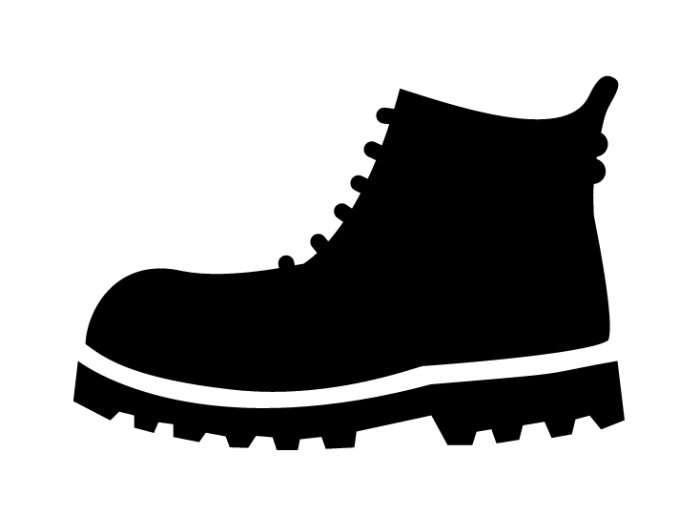

01
02
03
04
05
01
Introduction
Introduction
User Needs
Function
USE CASES
Demo
Why we chose this topic
Tough task to manage shoes
Notes:
Many people experience difficulty managing their own shoes in a decent and pleasant form. Especially for the people living alone, keeping shoes clean and sweet smelling becomes a tough task to manage. When it rains, shoes get wet and dirty. Can you imagine the smell and feel of the shoe? Even worse the smell starts from the entrance to the place where you will go to sleep. This is when the actual management features are required.

Slide 4



01
02
03
04
05
01
Introduction
Introduction
User Needs
Function
USE CASES
Demo
Why we chose this topic
What kind of problems
do we have?

Slide 5

01
02
03
04
05
02
User Needs
Introduction
User Needs
Function
USE CASES
Demo
Classifying the problems
and giving proper solutions
Classified problems
Dirty Shoes
Wet shoes
Bad smell
We do not understand our Shoes

Slide 6

01
02
03
04
05
02
User Needs
Introduction
User Needs
Function
USE CASES
Demo
Classifying the problems
and giving proper solutions
How can we solve the problem?
How do we keep our shoes in good shape?

Slide 7

01
02
03
04
05
02
User Needs
Introduction
User Needs
Function
USE CASES
Demo
Classifying the problems
and giving proper solutions
Proper Solutions
Environment Optimization
Weather forecast
& Recommending proper shoes
Deodorization
Understand our Shoes
By Shoes Analysis

Slide 8
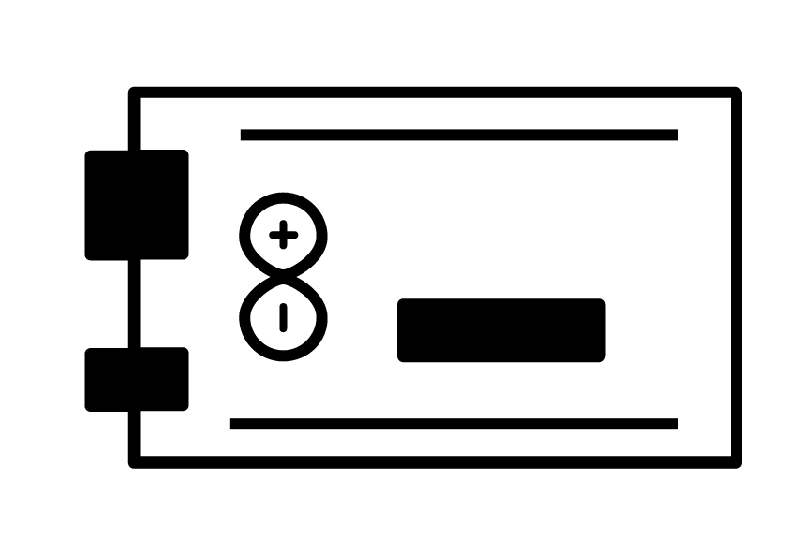




01
02
03
04
05
03
Function
Introduction
User Needs
Function
USE CASES
Demo
Function realization
Used technology
Functions
Optimization
Smart shoes care(IOT)
Analysis
Recommendation

Slide 9
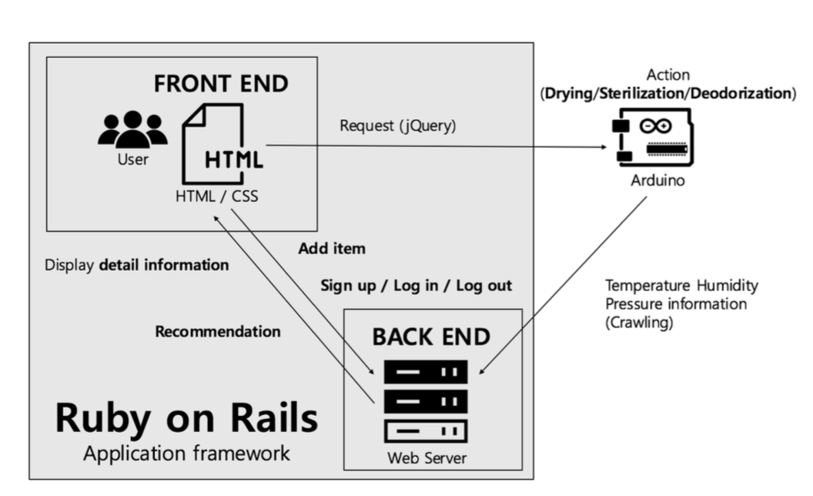
01
02
03
04
05
03
Function
Introduction
User Needs
Function
USE CASES
Demo
Architecture
Overall Architecture

Slide 10

01
02
03
04
05
03
Function
Introduction
User Needs
Function
USE CASES
Demo
. Optimizing environment
Arduino technology
using sensor we get information
WI-FI technology
make order to fan , lamp , deodorant , sterilizer
Pressure sensor
-Usage time
-Shoes in out
Temperature
Humidity sensor
Activate Arduino
-Electric fan
-Lamp
-Deodorant
-Sterilizer
Web

Slide 11




01
02
03
04
05
03
Function
Introduction
User Needs
Function
USE CASES
Demo
. Optimizing environment
Optimization
Temperature control – using electric fan
Humidity control – using ultraviolet lamp
Deodorization – using deodorant
Sterilization – using sterilizer

Slide 12
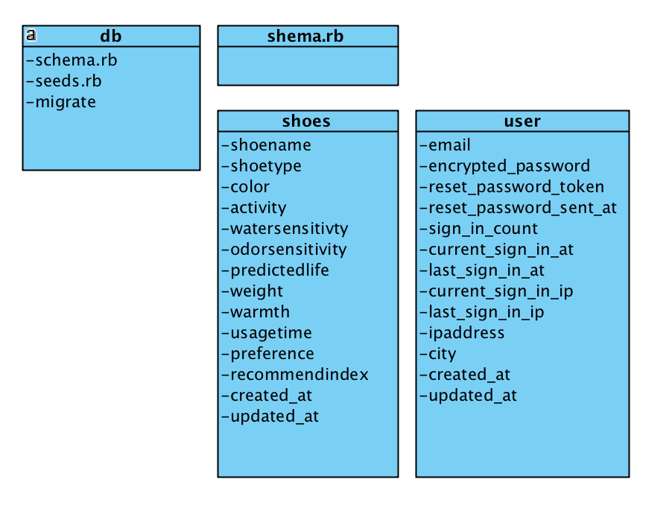
01
02
03
04
05
03
Function
Introduction
User Needs
Function
USE CASES
Demo
. Optimizing environment
Inside the Database
Analysis

Slide 13
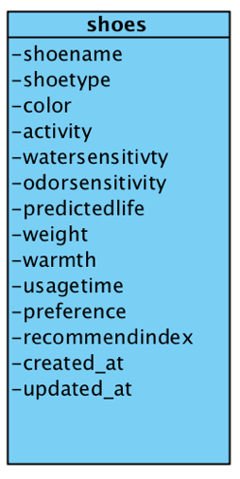

01
02
03
04
05
03
Function
Introduction
User Needs
Function
USE CASES
Demo
. Optimizing environment
Analysis
We set the shoes basic information
When a new shoe is added
to Smart Shoebox

Slide 14
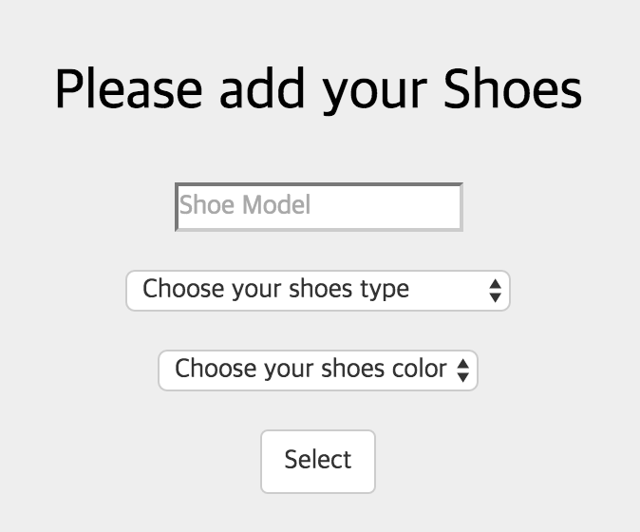
01
02
03
04
05
03
Function
Introduction
User Needs
Function
USE CASES
Demo
. Optimizing environment
Analysis

Slide 15
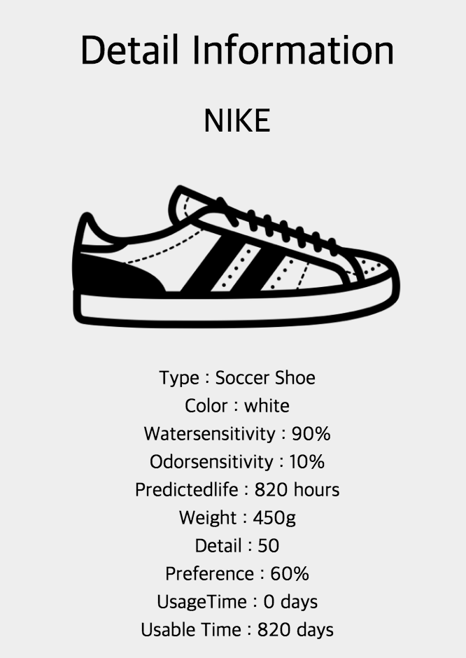
01
02
03
04
05
03
Function
Introduction
User Needs
Function
USE CASES
Demo
. Optimizing environment
Analysis

Slide 16

01
02
03
04
05
03
Function
Introduction
User Needs
Function
USE CASES
Demo
Shoes recommendation
4.Recommendation - stand on the basis of shoes capacity and weather and user schedule and Algorithm – measurement index
Shoes capacity(database)
Shoes warmth
Shoes activity
Shoes color
Present weather(API on Web)
Rain , snow , cloud etc
temperature

Slide 17


01
02
03
04
05
03
Function
Introduction
User Needs
Function
USE CASES
Demo
Shoes recommendation
4.Recommendation - stand on the basis of shoes capacity and weather and user schedule and Algorithm - measurement index
user schedule
-based on user’stype of schedule
- Todays activity type
User Preference
-base on statistic(pressure sensor)
- Usage of month

Slide 18
01
02
03
04
05
03
Function
Introduction
Customer Needs
function
USE CASES
Demo
Weather confirmation
5. Weather check
- With weather API, user can check local weather
Rain?
Snowing?
Cloud?
Later?
Warm?
Cold?
Hot?
At afternoon

Slide 19
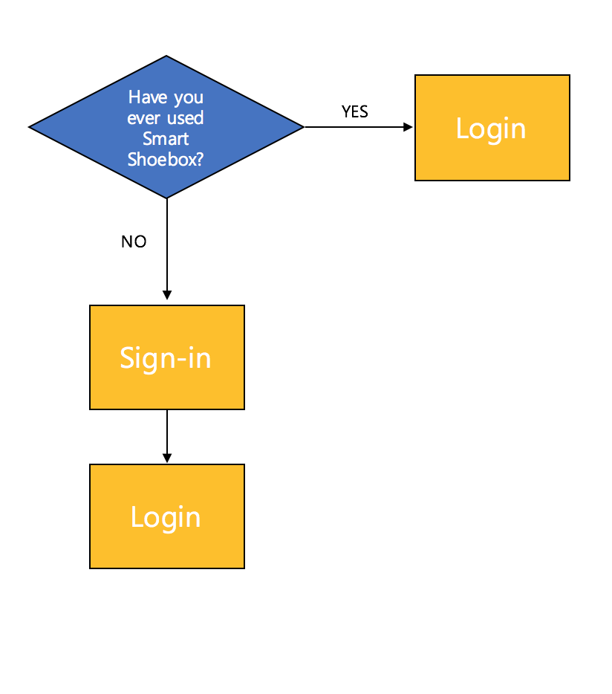
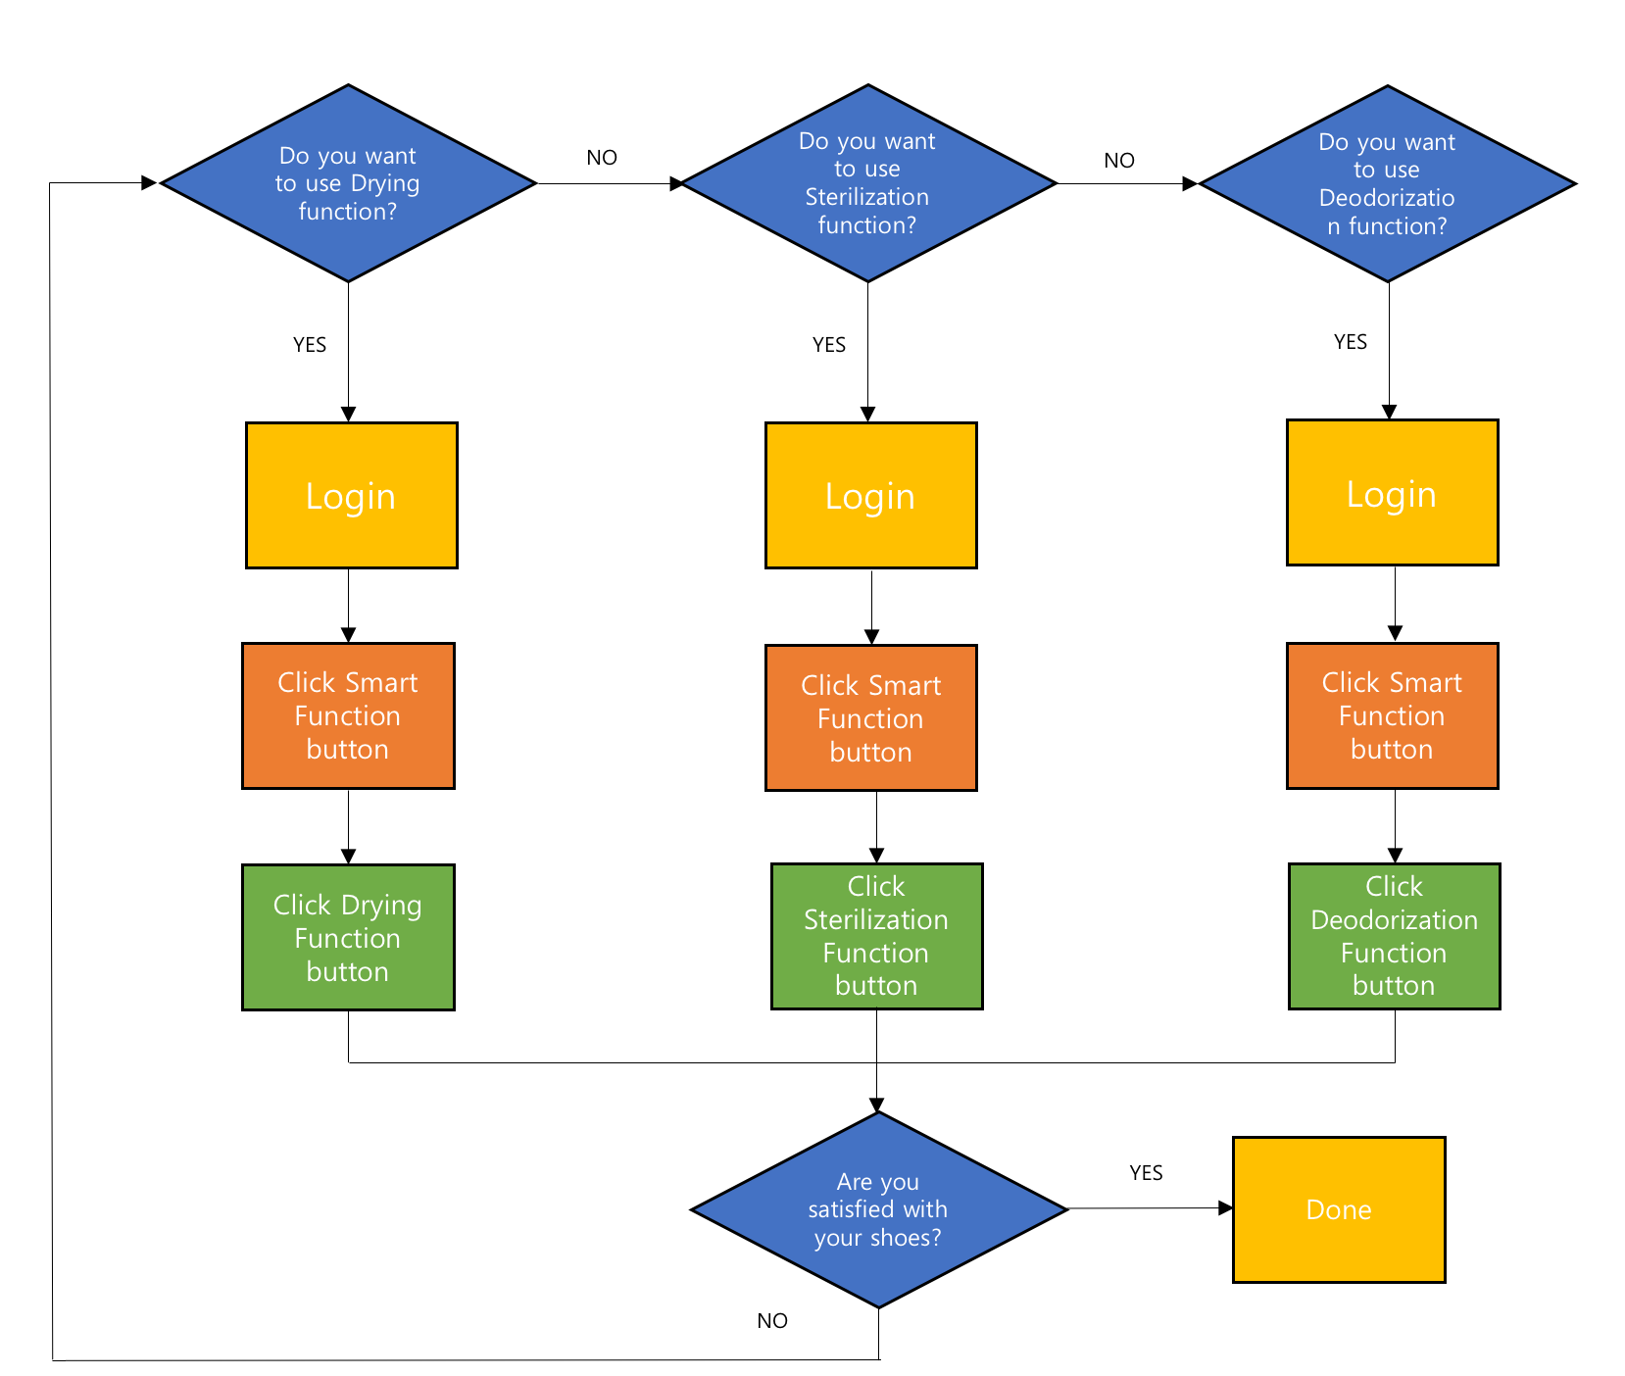
01
02
03
04
05
04
Use case
Introduction
Customer Needs
function
USE CASES
Demo
Use case
Starting smart shoebox
Operate smart function

Slide 20
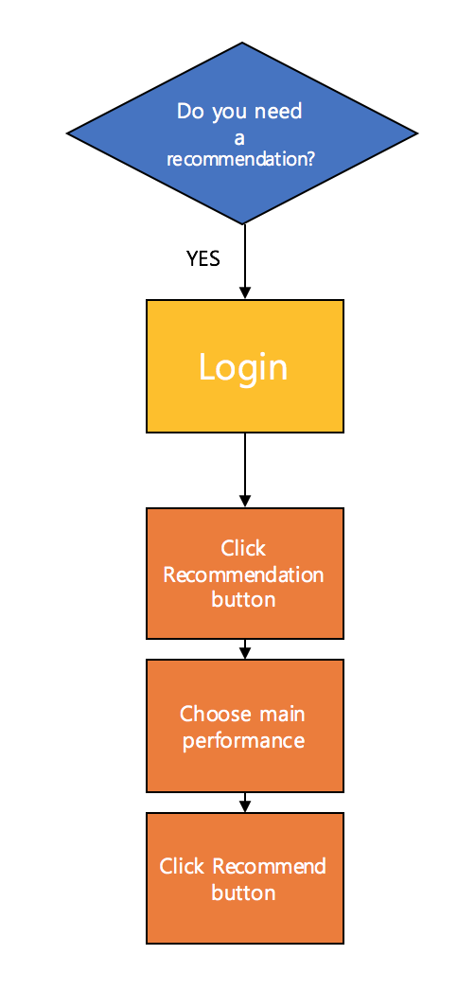
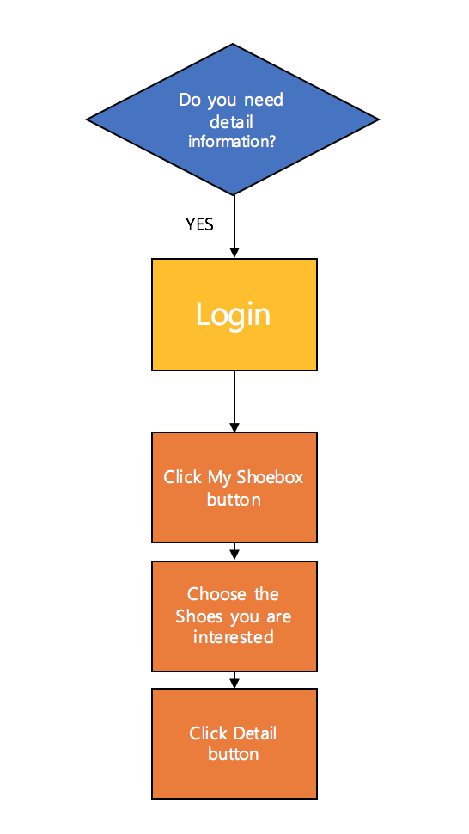
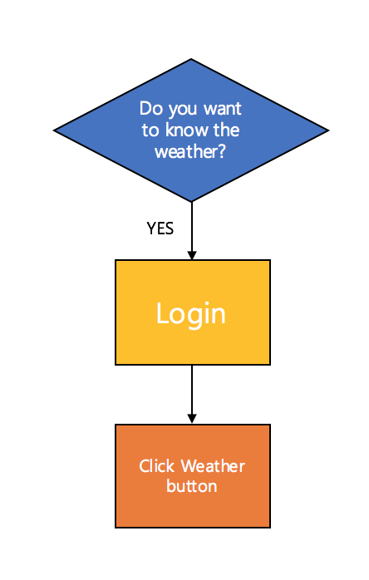
01
02
03
04
05
04
Use case
Introduction
Customer Needs
function
USE CASES
Demo
Use case
Shoes recommendation
My shoebox - information
Weather confirmation

Slide 21

01
02
03
04
05
05
Demo
Introduction
Customer Needs
function
USE CASES
Demo
Now we will show you how it actually works!

